Slide 2
Mentoring
Is it your most powerfull networking tool?

Slide 3
Agenda
What is Mentoring/Mentorship
What is a Mentor
What is a Mentee
What types of Mentorship are there
Why is this useful
How you can get started
My Personal Story

Slide 4
What is Mentoring?

Slide 5
What is Mentoring?
Special type of Relationship called a Mentorship
Similar to the Employee/Manager relationship
Loosely similar to Parent/Child relationship
Loosely similar to the elder/younger sibling relationship
Bi-directional
With more weight towards the mentee than the mentor
Often Goal driven

Slide 6
What makes a Mentor?

Slide 7
What makes a Good Mentor?
Typically someone with life experience
Typically in an area that facilitates sharing that experience
Often in senior roles, but not always
Good example of this is a mentor for first year university students.
They know how to follow and then lead & direct a conversation.
Often have an extensive and wide network.

Slide 8
What makes a Mentee?

Slide 9
What makes a Mentee?
Anyone that wants to expand & stretch themselves
Moving onto a new area of their career
Management being a common one
Moving into a new company
Looking to progress in current organisation
Potentially looking at bettering themselves in a non-career focused area

Slide 10
What type of Mentorship are there?

Slide 11
What type of Mentorship are there?
Direct
Both Mentor & Mentee are aware of the Mentorship
This type often has more formality in place
Goal based outcomes
Often have a Time boxed duration
Indirect
Typically only one of the parties are aware of it
Less formal

Slide 12
What type of Mentorship are there?
Direct
Both Mentor & Mentee are aware of the Mentorship
This type often has more formality in place
Goal based outcomes
Often have a Time boxed duration
Indirect
Typically only one of the parties are aware of it
Less formal

Slide 13
Why is this useful?

Slide 14
Why is this useful?
Mentoring can help give directional growth.
Seeking out a Mentor/Mentee shows you are in growth mindset

Slide 15
How do we get started

Slide 16
How do we get started
Firstly, As a Mentor
Decide what you want to & are capable of providing mentorship around
Firstly, As a Mentee
As either
Work out how much time you want to and can realistically dedicate to this
Ideally, set some mutually agreed goals

Slide 17

How do we get started
Download Tribute from the App Stores
Build your profile
Include your story
Promote that you are looking for a Mentor/Mentee
LinkedIn, Twitter, Internally in your org
Wait

Slide 18
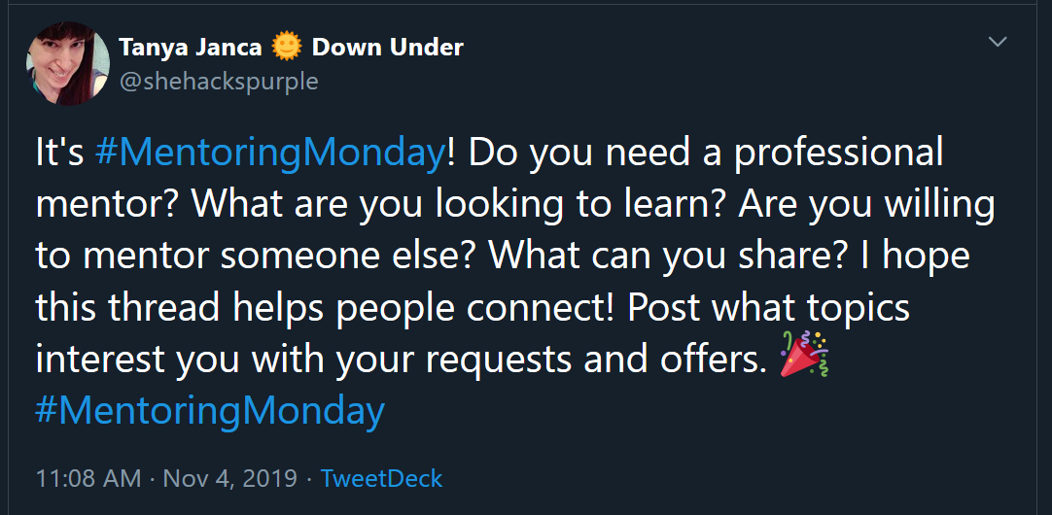
How do we get started

Slide 19
My story
Notes:
Tell of my stories having had both Direct & Indirect Mentors
Martyn S – Direct - Finance
Matt H – Indirect - Finance, Community
Mark S – Direct - Community
Tobias W – Indirect - Community

